Slide 1
MYLEGION ADMIN:
MEMBER MANAGEMENT
Manage LGN and SAL membership. View, edit, print membership card, assign group permission, and email a single member or group of members.
July 2024
Notes:
MyLegion administrative tools include member management for The American Legion and Sons of The American Legion members.

Slide 2
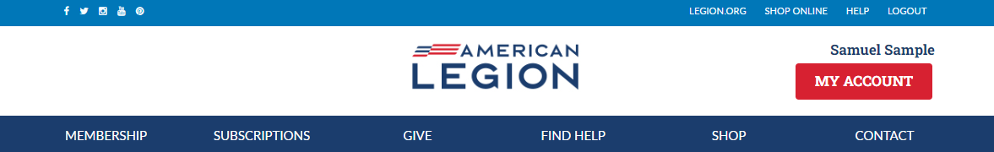
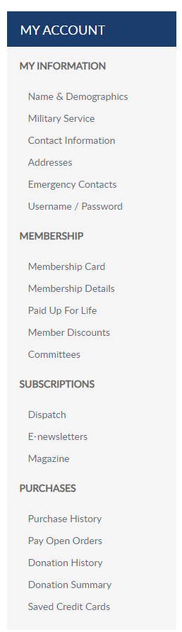
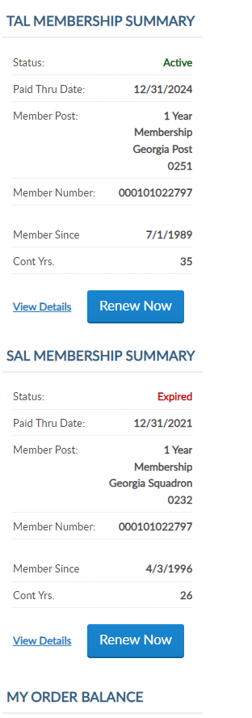
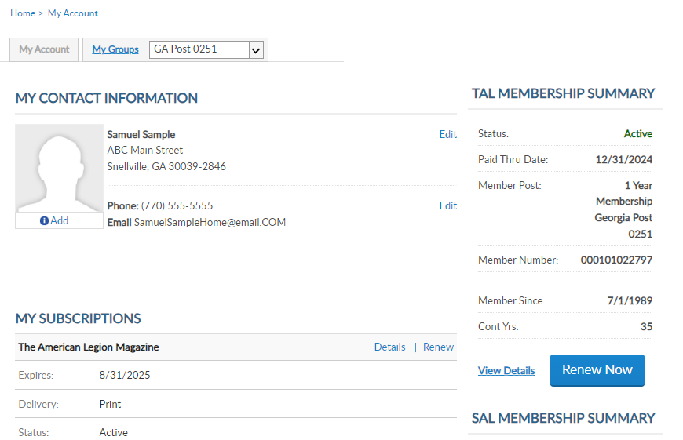
MYLEGION.ORG
My Account
Personal Member Info
My Groups
Adjutants & Commanders
Post, Squadron
District, County (View only)
Department, Detachment
Assigned Administrators
123456789
123456789
Notes:
When you log into MyLegion your My Account page displays information about your individual membership.
Adjutants and commanders of posts, squadrons, districts, counties, departments and detachments will have a My Groups menu when they are recorded in national’s membership system. The group menu is related to your position as an adjutant and commander. Members who have been assigned permission by one of the administrative officers will also have a My Groups menu. My groups is the administrative side of myLegion.

Slide 3
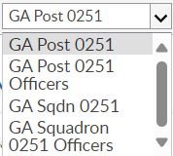
MYLEGION.ORG
My Groups Menu
Post Adjutant & Commander
  Post
  Post Officers (view only)
  Squadron
  Squadron Officers (view only)
123456789
123456789
Notes:
This member is a post adjutant and has 4 groups by default. <1> Legion leadership have access to both Legion and Sons of the American Legion groups. Officer groups are view only to see contact information for officers on file.
Clicking on the group will navigate you to the administrative side of MyLegion.

Slide 4
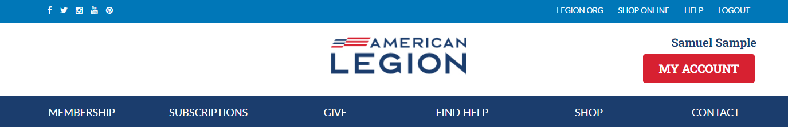
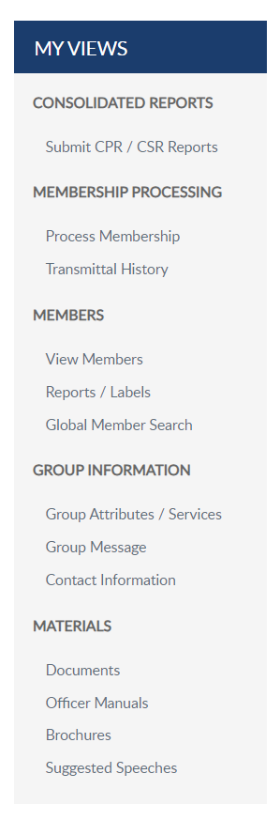
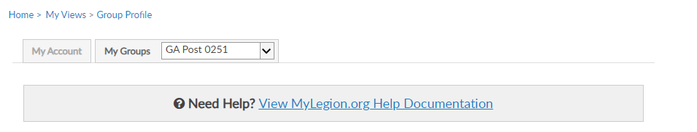
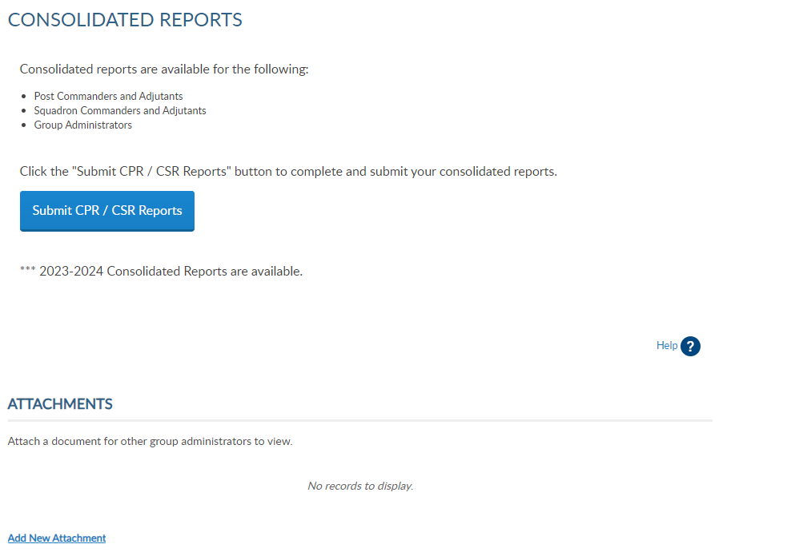
GROUP PROFILE
Consolidated Reports
Online CPR/CSR
Membership Processing
Renew, Add, Transfer
Members
View Members / Mbr Management
Reports
Group Information
Contact Information
Materials
Manuals, Brochures, Speeches
Notes:
The groups area has a left hand “My Views” menu with links to administrative tools. Consolidated reports, online membership processing, reports, member management, group information and officer materials.
<1> Click on View Members to view members in the group selected.

Slide 5
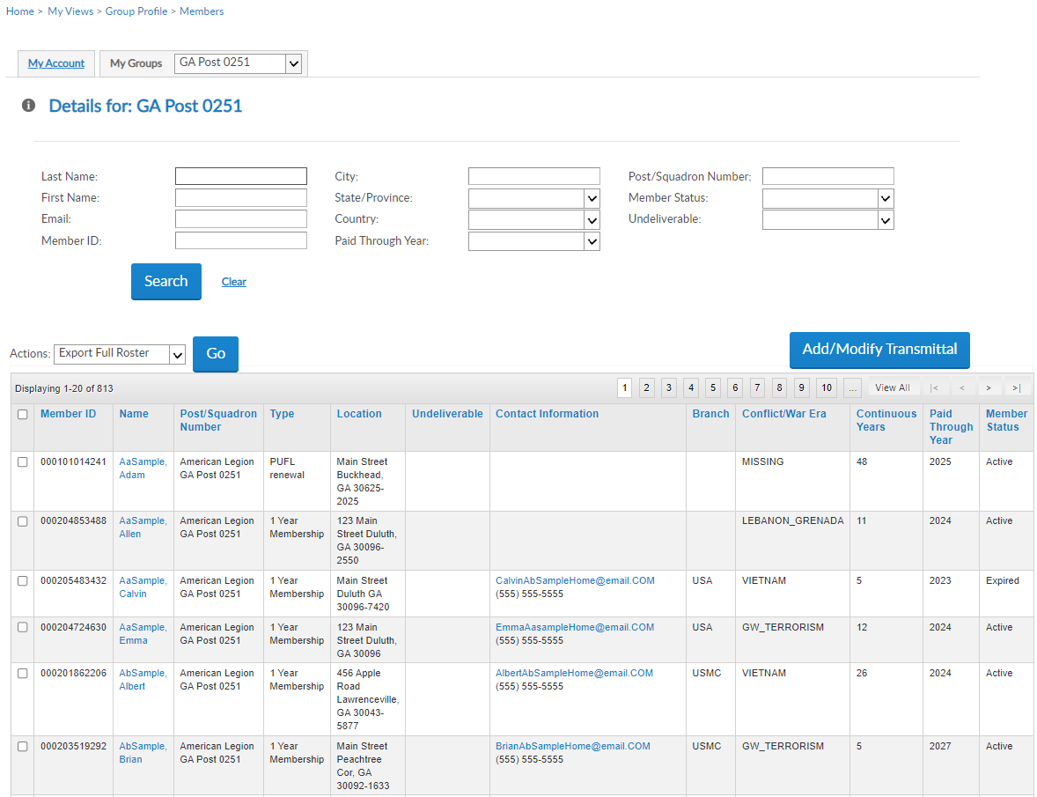
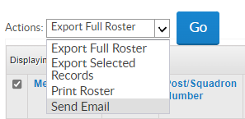
VIEW MEMBERS
View Members List
Contact Information
Member Status
Search Members
Reports located in another menu option Filter Options
Edit
Send Emails
Add/Modify Transmittal
Not available to districts and counties.
000123456781
000123456782
000123456783
000123456784
000123456789
**
000123456786
Notes:
View members includes current, deceased and expired members. It does not include members who have transferred out. View Member’s list provides a quick view of member contact information and status.
Search filters allow you to search a member or group of members. Do not use view members for reports. Reports are located in another menu option. To create a roster, return to group profile and go to Reports/Labels.​
​
You can click on an email address of an individual to send an email or filter a group to send a group email. When sending group emails, click “View All” to load the list on one page. Select all names by clicking the box in the title row. <1> Go to the actions menu and select “Send Email” and click Go.
The Add/Modify button is only available to posts, squadrons, detachments, and departments. It opens online membership processing. District and County access allows view only. District and County access will not include Add/Modify transmittal. Learn more about online membership processing in Find Help.

Slide 6
VIEW MEMBERS
000123456781
JohnZaSampleHome@email.COM
2025
Expired
000351234567
ZaSample, John
PO Box ABC
Duluth, GA 30096-2550
000123456782
000123456783
000123456784
000123456789
**
000123456786
Notes:
The member list includes all members of the post members since I am in the post group.
The view members list is alphabetical. Click on any of the title columns to resort and navigation icons to go from page to page. <1> New members in a pending transmittal will be in the list as expired with zero continuous years. When the transmittal completes the status updates to Active with 1 continuous membership year. ​
The view member list includes member contact and demographic information, last paid membership year and status. Members who have transferred out, will not be included in this listing. To view all members that have paid to your post, including those transferred out, go to Reports to generate a Paid Member Listing.​
​To edit member information, click on the member’s name. <2>
​
​

Slide 7
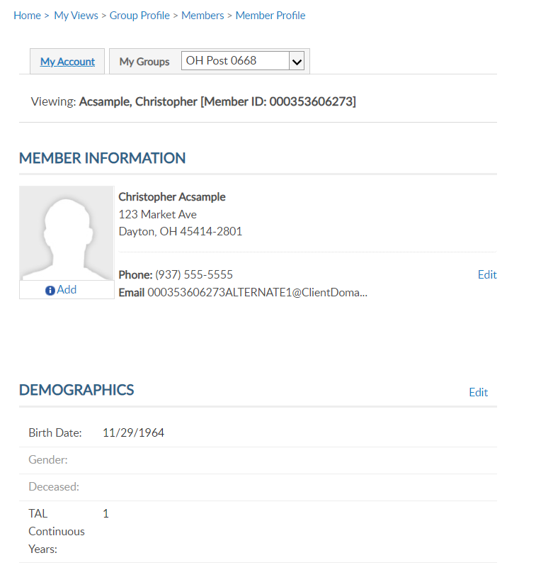
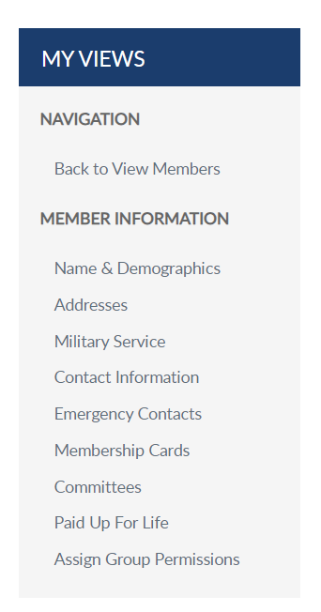
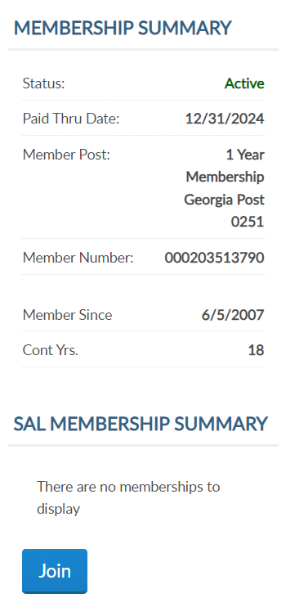
MEMBER INFORMATION
Viewing: AbSample, Albert [Member ID: 123456789]
Albert AbSample
456 Apple Road
Lawrenceville, GA 30043-5877
Phone: (555) 555-5555
Email: AlbertAbSampleHome@email.COM
000123456789
6/5/1998
26
26
Notes:
Viewing a member displays the member’s name, ID#, contact information, demographics, and membership summaries. For members of both The American Legion and Sons of the American Legion, both membership summaries are displayed. <1>Summaries include status, paid through year, membership type, and continuous years. The membership ID number is the same for both memberships.

Slide 8
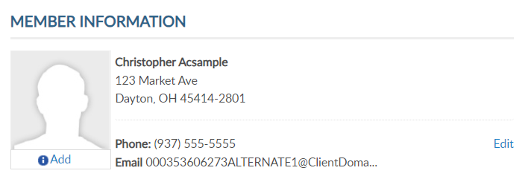
C0NTACT INFORMATION
Viewing: AbSample, Albert [Member ID: 123456789]
Albert AbSample
456 Apple Road
Lawrenceville, GA 30043-5877
Albert AbSample
456 Apple Road
Lawrenceville, GA 30043-5877
Phone: (555) 555-5555
Email: AlbertAbSampleHome@email.COM
Phone: (555) 555-5555
Email: AlbertAbSampleHome@email.COM
26
Notes:
Contact information includes phone number and email address. You can edit or add contact information by clicking the edit button in member information. You can also select the link from the side menu. <1>

Slide 9
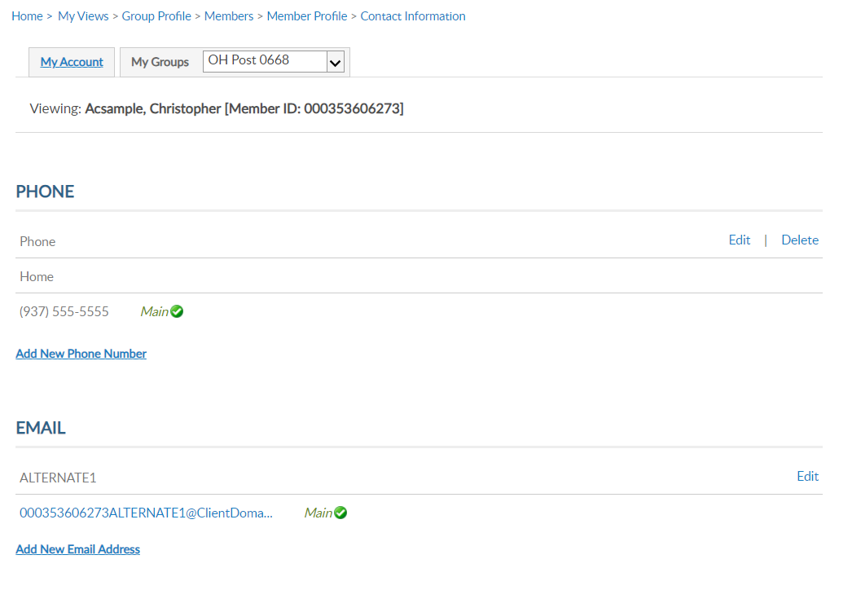
CONTACT INFORMATION
Viewing: AbSample, Albert [Member ID: 123456789]
Viewing: AbSample, Albert [Member ID: 123456789]
Albert AbSample
456 Apple Road
Lawrenceville, GA 30043-5877
(555) 555-5555
Phone: (555) 555-5555
Email: AlbertAbSampleHome@email.COM
HOME
AlbetAbSampleHOme@email.COM
26
Notes:
Contact information includes phone and email information. Using, edit, delete or add update as needed.
Member’s can have multiple emails and phone numbers. A total of 3 emails can be on a member’s record.
Updating the main email address updates the email associated with your myLegion account. All email communications for myLegion password and username are sent to the main email address.
If one email is on file, no delete option will be available. An email must exist on your record to have a myLegion account. In the event you do want to delete your email address, contact National MyLegion support staff.

Slide 10
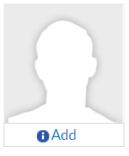
ADD / MANAGE IMAGE
Viewing: AbSample, Albert [Member ID: 123456789]
Albert AbSample
456 Apple Road
Lawrenceville, GA 30043-5877
Phone: (555) 555-5555
Email: AlbertAbSampleHome@email.COM
26
Notes:
Members and Administrative officers can upload a picture by clicking Add. <1>

Slide 11
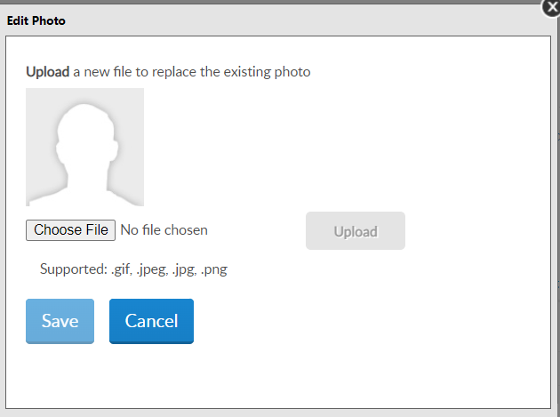
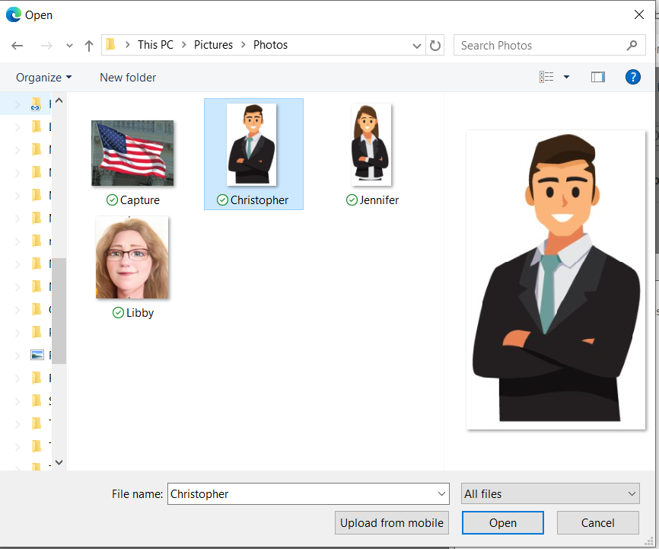
ADD / MANAGE IMAGE
Albert
Notes:
The edit photo window opens for you to choose your image to display. Only the supported file types can be selected. Select “Choose File” and <1>
locate the image file. Select the file and click Open. <2>

Slide 12
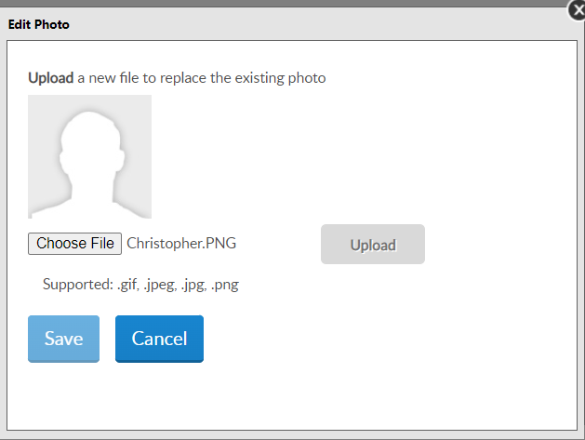
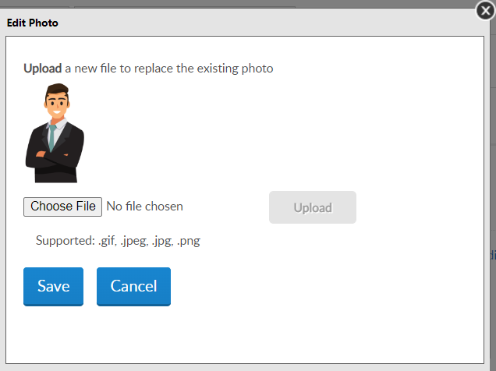
ADD / MANAGE IMAGE
Albert.PNG
Notes:
The file name appears. Select “Upload”. <1> The image displays. Click Save <2> to save image or cancel and no image will be saved on the member’s record.

Slide 13
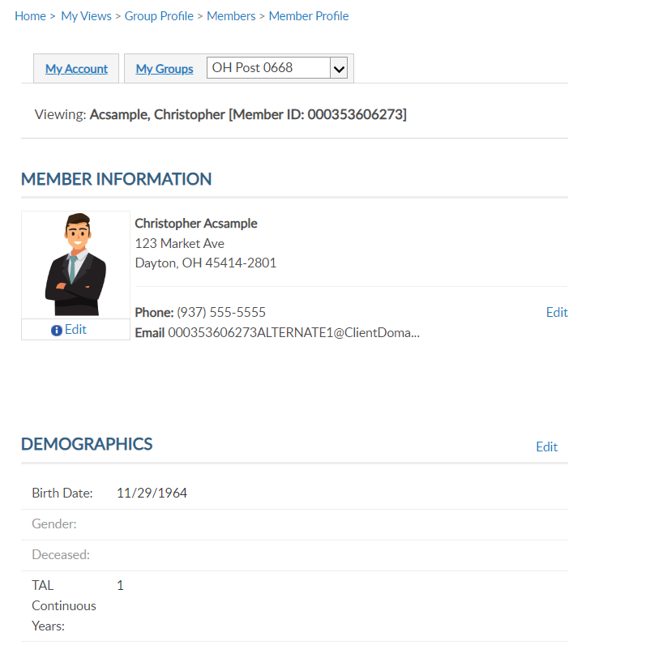
NAME & DEMOGRAPHICS
Viewing: Acsample, Christopher [Member ID: 123456789]
Viewing: AbSample, Albert [Member ID: 123456789]
Address update only.
Albert AbSample
456 Apple Road
Lawrenceville, GA 30043-5877
Phone: (555) 555-5555
Email: AlbertAbSampleHome@email.COM
26
Notes:
Once you add an image, you can edit or remove by clicking on Edit below the image.
The main view member information page and has edit links <1> to update address, phone number, date of birth, gender, deceased status and continuous years. The sections are separate. To update a member’s name, you must use the left menu option for Name & Demographics <2>.

Slide 14
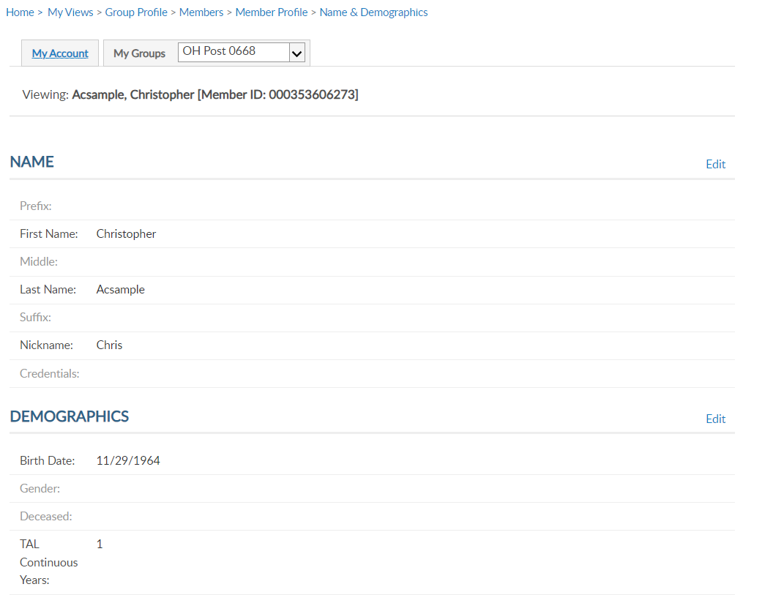
NAME & DEMOGRAPHICS
Viewing: AbSample, Albert [Member ID: 123456789]
Viewing: Acsample, Christopher [Member ID: 123456789]
Viewing: AbSample, Albert [Member ID: 123456789]
Albert AbSample
456 Apple Road
Lawrenceville, GA 30043-5877
Albert
AbSample
Phone: (555) 555-5555
Email: AlbertAbSampleHome@email.COM
Al
26
12
Notes:
This area has 2 sections, each with an edit button. Use the top edit button to edit name. Date of birth, gender, deceased status and continuous years can be maintained in Demographics. Click edit in the demographics section.<1>

Slide 15
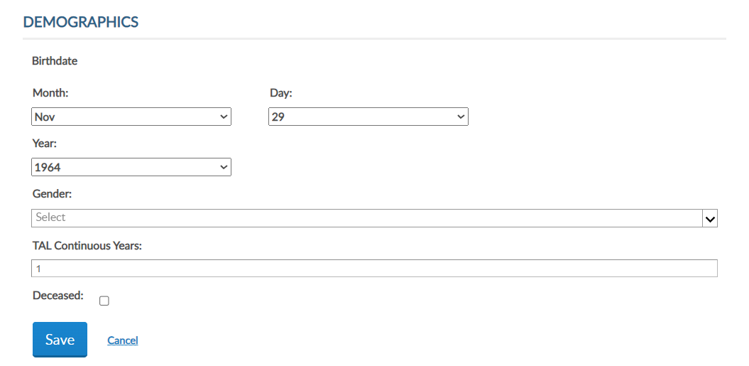
NAME & DEMOGRAPHICS
Viewing: AbSample, Albert [Member ID: 123456789]
Albert
AbSample
Al
26
26
Notes:
To update date of birth, gender, continuous years and deceased status, click on the Edit button in the Demographics area. <1> Enter updates and Save. Please note, you cannot remove deceased status through MyLegion. If a member is flagged as deceased in error, contact your department headquarters.

Slide 16

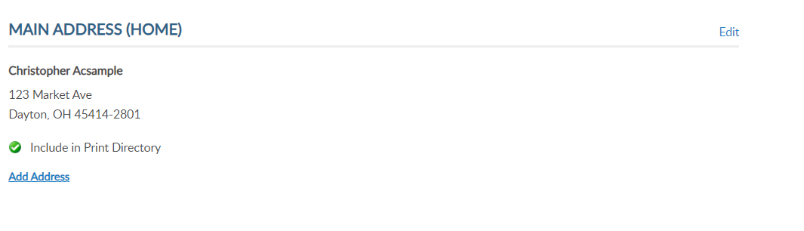
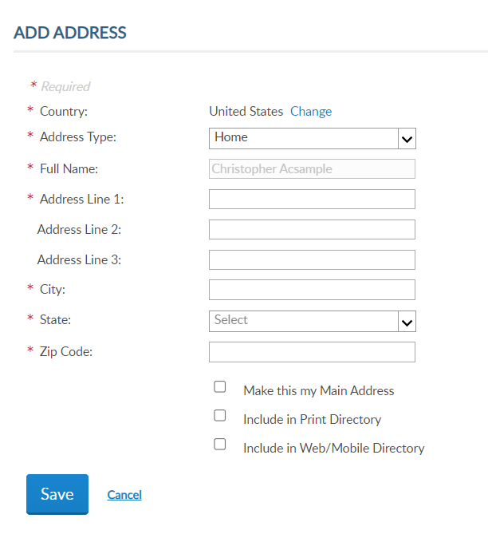
ADDRESSES
Viewing: Acsample, Christopher [Member ID: 123456789]
Viewing: AbSample, Albert [Member ID: 123456789]
Albert AbSample
456 Apple Road
Lawrenceville, GA 30043-5877
Albert AbSample
456 Apple Road
Lawrenceville, GA 30043-5877
Phone: (555) 555-5555
Email: AlbertAbSampleHome@email.COM
26
Notes:
Addresses allows you to update existing addresses or add an additional address to the member’s record. Members are required to have one main, or primary, address. The primary address listed on a member record determines where the address communications are sent for renewal notices, campaigns, and membership information. The main address cannot be deleted.
Some members may need an additional address on file for mailing subscriptions, or committee and officer correspondence. To add an additional address, click Add Address. <1> Selecting “Make this my main address” will make this your primary mailing address. Enter address information and save.

Slide 17
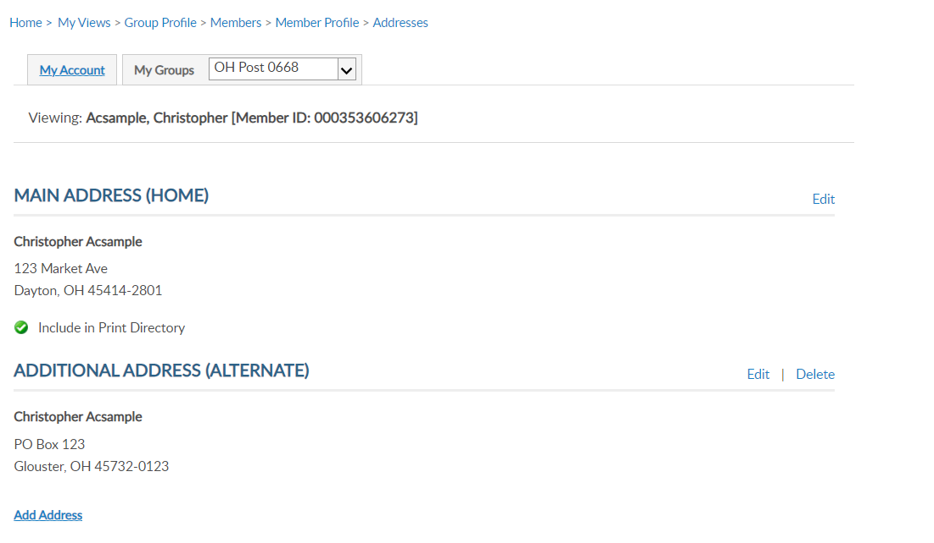
ADDRESSES
Viewing: AbSample, Albert [Member ID: 123456789]
Albert AbSample
456 Apple Road
Lawrenceville, GA 30043-5877
Albert AbSample
PO Box 123
Lawrenceville, GA 30043-5877
Notes:
The member record now has 2 addresses on file. Notice delete is now available. Delete only appears for alternate contact information.

Slide 18
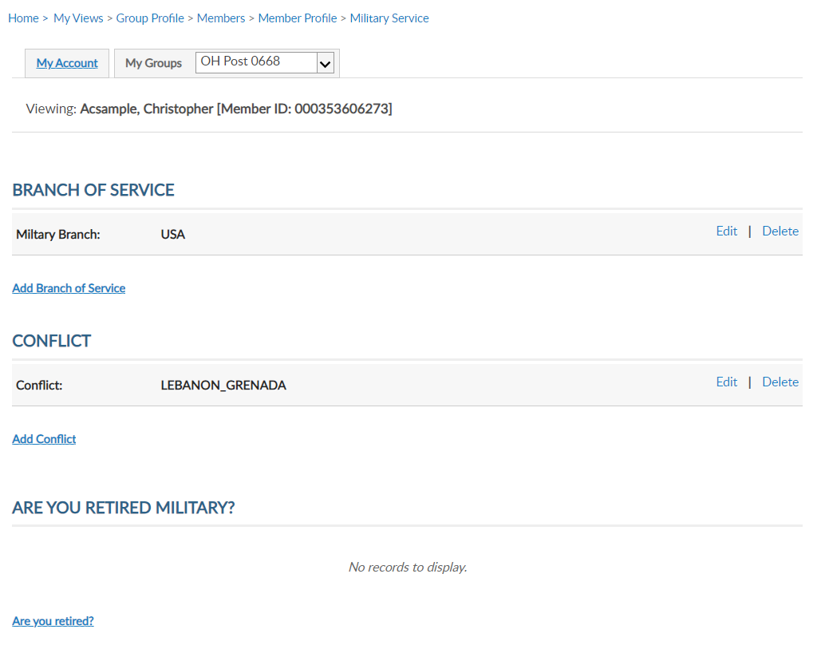
MILITARY SERVICE
Viewing: AbSample, Albert [Member ID: 123456789]
Viewing: Acsample, Christopher [Member ID: 123456789]
Viewing: AbSample, Albert [Member ID: 123456789]
Albert AbSample
456 Apple Road
Lawrenceville, GA 30043-5877
Phone: (555) 555-5555
Email: AlbertAbSampleHome@email.COM
26
Notes:
Military Service includes branch of service, conflict and retirement information.
MyLegion allows multiple selections to be stored on the member record. Use the links to Edit, Delete or Add branch of service and conflict.

Slide 19
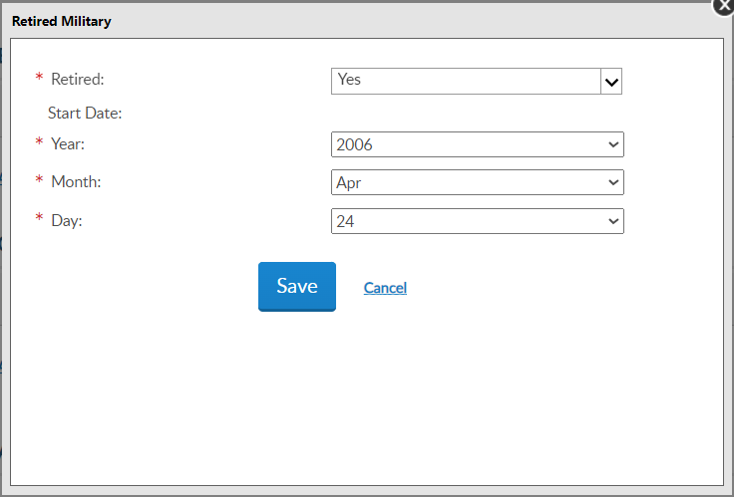
MILITARY SERVICE
Viewing: AbSample, Albert [Member ID: 123456789]
Notes:
You can also store retirement information. To add retirement information, click on the link Are you Retired? <1> Enter the date retired and Save.

Slide 20
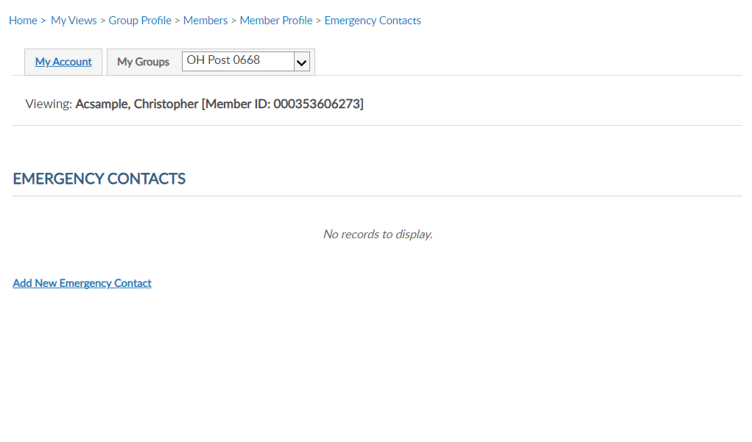
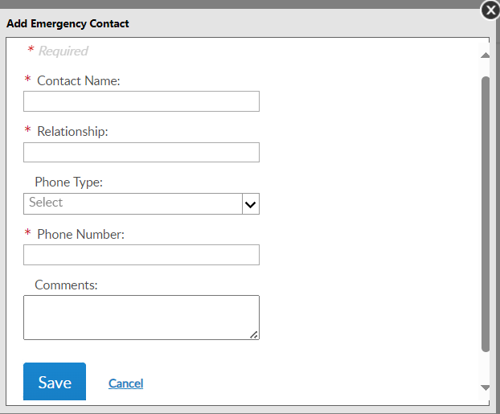
EMERGENCY CONTACTS
Viewing: AbSample, Albert [Member ID: 123456789]
Viewing: Acsample, Christopher [Member ID: 123456789]
Viewing: AbSample, Albert [Member ID: 123456789]
Albert AbSample
456 Apple Road
Lawrenceville, GA 30043-5877
Phone: (555) 555-5555
Email: AlbertAbSampleHome@email.COM
26
Notes:
Store emergency contact information in case of an emergency. <1> Enter emergency contact name, relationship, phone number, any comments and “Save”. - This information can be seen by department and national staff in case of an emergency if the member attends events and conventions or local activity of The American Legion or Sons of The American Legion.

Slide 21
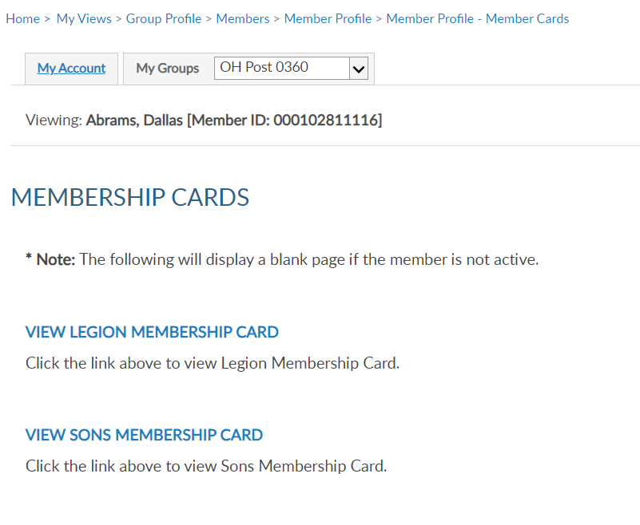
MEMBERSHIP CARDS
Viewing: Acsample, Christopher [Member ID: 123456789]
Viewing: AbSample, Albert [Member ID: 123456789]
Viewing: AbSample, Albert [Member ID: 123456789]
Albert AbSample
456 Apple Road
Lawrenceville, GA 30043-5877
Phone: (555) 555-5555
Email: AlbertAbSampleHome@email.COM
26
Notes:
Print a membership card for a member. Click “membership card”. <1> Members who have both Legion and Sons of the American Legion members will have 2 options. Only current membership cards are available. This page will display as blank if membership is not active. Click on the link to view and print a card.

Slide 22
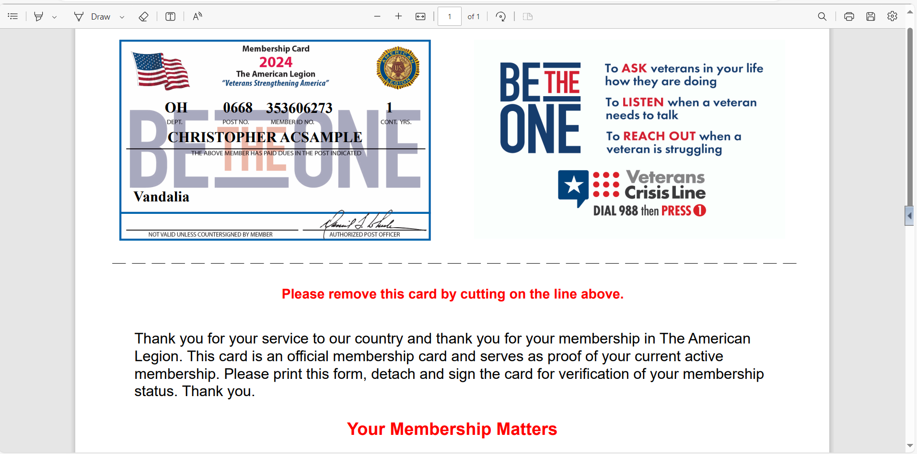
MEMBERSHIP CARDS
GA 0251 123456789 26
Albert AbSample
Duluth
Notes:
A pdf document will open in your browser to save or print. <1>

Slide 23
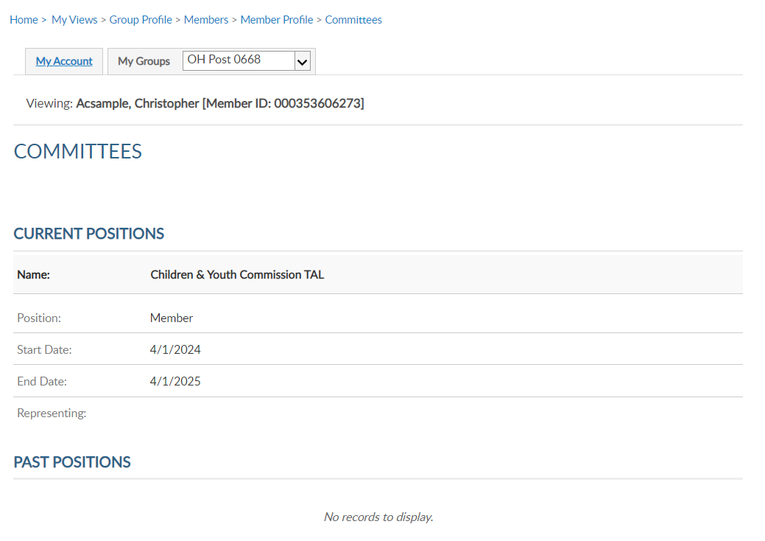
COMMITTEES
Viewing: AbSample, Albert [Member ID: 123456789]
Viewing: Acsample, Christopher [Member ID: 123456789]
Viewing: AbSample, Albert [Member ID: 123456789]
Albert AbSample
456 Apple Road
Lawrenceville, GA 30043-5877
Phone: (555) 555-5555
Email: AlbertAbSampleHome@email.COM
26
Notes:
Committees lists offices held that are recorded on National’s membership system. It will display current and past positions.
This area is view only and reflects officers reported to National HQs. Officer updates are reported through your department using a post officers certification form. Incorrect committee information should be reported to your department.

Slide 24
PAID UP FOR LIFE
Viewing: Acsample, Christopher [Member ID: 123456789]
Viewing: AbSample, Albert [Member ID: 123456789]
Albert AbSample
456 Apple Road
Lawrenceville, GA 30043-5877
Phone: (555) 555-5555
Email: AlbertAbSampleHome@email.COM
26
Notes:
Paid up for life allows you to assist members with the online application.
Members that are already PUFL and expired members, will result in an error. Proceeding through the application provide the cost for PUFL membership either paid in full or using the 12-month payment plan.

Slide 25
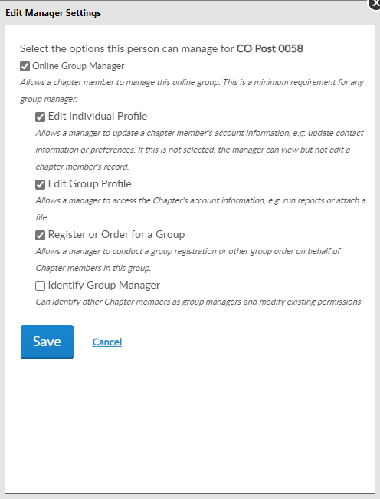
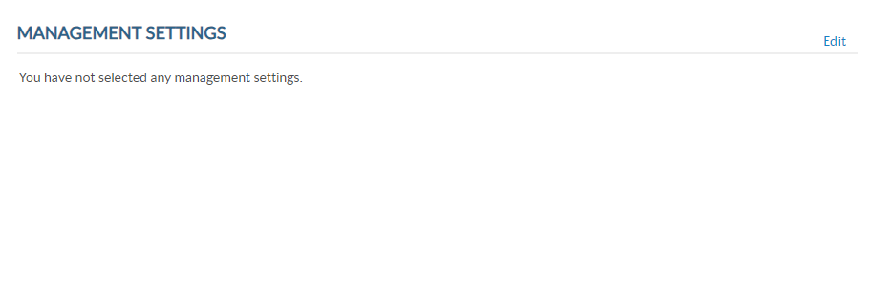
ASSIGN GROUP PERMISSIONS
GA Post 0251
Viewing: AbSample, Albert [Member ID: 123456789]
Notes:
Assign group permissions should be used with caution. This tool allows adjutants and commanders to grant access to post and squadron membership to other members.
To add, delete or edit management settings, click edit. <1>

Slide 26
ASSIGN GROUP PERMISSIONS
GA Post 0251
Online Group Manager
Minimum Requirement
View and print member list.
Quick link to email address.
Notes:
To provide the same access adjutants and commanders have select:
Online Group Manager. This is the minimum permission requirement. It provides access to view members and a quick link to member email addresses. Selecting this option only results in view only and records cannot be updated.

Slide 27
ASSIGN GROUP PERMISSIONS
GA Post 0251
Edit Individual Profile
Edit member information
Edit Group Profile
Online Membership Tools: View Members, Global Member Lookup, Group Attributes, Reports/Labels, and Officer Materials.
Notes:
Check Edit Individual Profile to grant authority to add and edit member information. <1> Edit Group Profile provides access to View Members, Global Member Search, Group Attributes. Reports, Letters, Labels and Officer Materials.

Slide 28
ASSIGN GROUP PERMISSIONS
GA Post 0251
Register or Order for a Group
Allows online membership processing, Add/Modify Transmittal.
Identity Group Manager
ADJUTANTS AND COMMANDERS ONLY.
Notes:
Register or Order for a group isthe setting to allow other members to process membership online using Add/Modify transmittal. This permission allows the member to renew, transfer and add new members as well as update payment information.
<1> The last setting is only available to adjutants and commanders. This setting allows the member to provide management settings for other members.
After the desired management settings are assigned, click on the Save button.

Slide 29
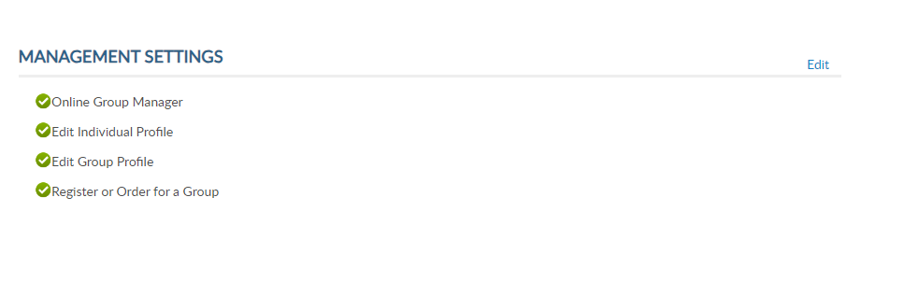
ASSIGN GROUP PERMISSIONS
Viewing: AbSample, Albert [Member ID: 123456789]
* Monitor access using MyLegion Access report.
* Contact department headquarters to add end date.
Notes:
Permissions added will display. The next time the member logs into their myLegion account, they will have access to group membership. Notice I am in the post group. Permissions are set for post group only. To give permission to squadron membership, go to the squadron group first, find the member, and set permissions.
Select back to view members to search more names or select Group Profile to return to the group home page.
No end date is set when applying these permissions. Permissions can be removed by returning to Edit and unchecking the selections. It is important to keep track of anyone given permissions.
<1> You can monitor members with access to your group in MyLegion in reports. Learn more about reports in Find Help. <2> To ensure members with permissions are monitored we suggest you contact your department headquarters or MyLegion support team to add an end date. Adding an end date will remove permissions to allow any new officers or existing officers to review the members administrative needs and re-assign if needed.
<3> Click Back to View Members to return to the member listing.

Slide 30
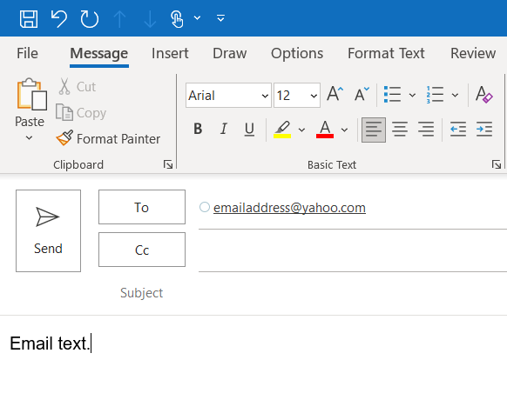
EMAIL MEMBER
Email a Single Member
CalvinAbSampleHome@email.com
000123456781
000123456782
000123456783
000123456784
000123456789
000123456786
Notes:
Emails can be sent from MyLegion. From the View Members listing, you can search a member, or a group of members and send an email.
To email an individual member, search them and click on the email hyperlink. <1> This opens your email browser to write and send an email. <2>
The default email browser is Microsoft Outlook. If you are using another browser such as Gmail or yahoo, it will be required to set your browser-based email default preference.
The number of records emailed at one time and per day is also limited per the email client. Generally, 100 per email and 500 per day. Check with the email client for limitations.

Slide 31
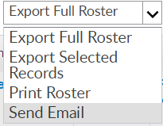
Email a Group of Members
EMAIL MEMBERS
000123456781
000123456782
000123456783
000123456784
000123456789
000123456786
Notes:
Email a group of members by first selecting view all. Select all records by clicking the checkbox in the title row. Using the Actions menu, <1> choose Send Email and click Go.

Slide 32
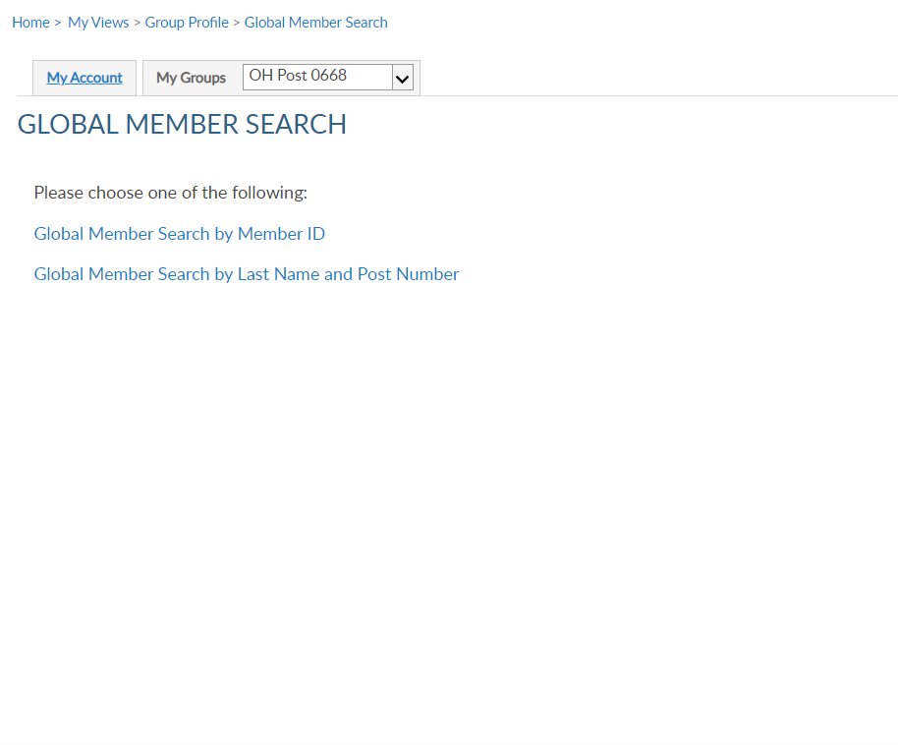
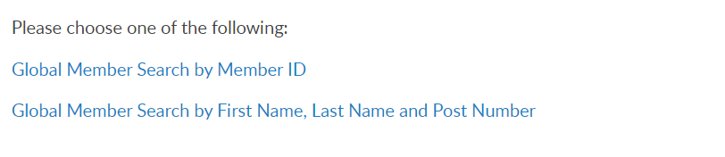
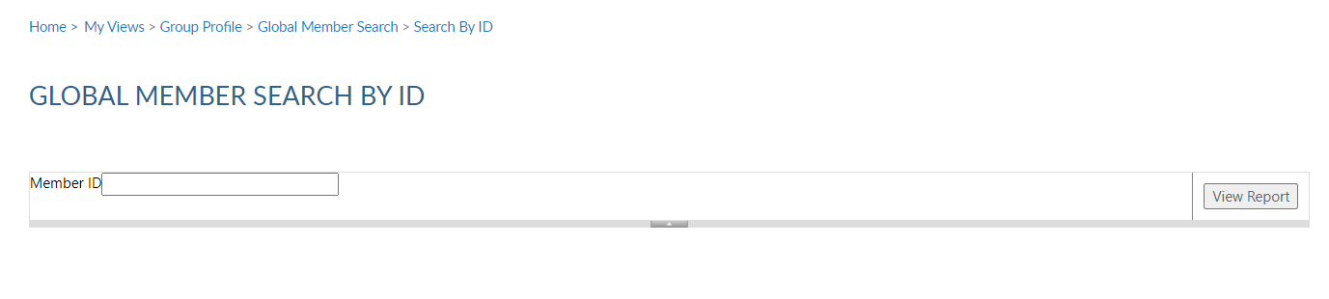
GLOBAL MEMBER SERACH
Notes:
Global member search allows you to view members outside of your group. 2 options are provided. Search by ID or search by name with post number.
<1> Search by ID allows you to enter a Legion or Son of The American Legion membership number to view limited information. Enter the ID#, click View Report <2> to view name, member type, paid post or squadron, and last paid year.

Slide 33
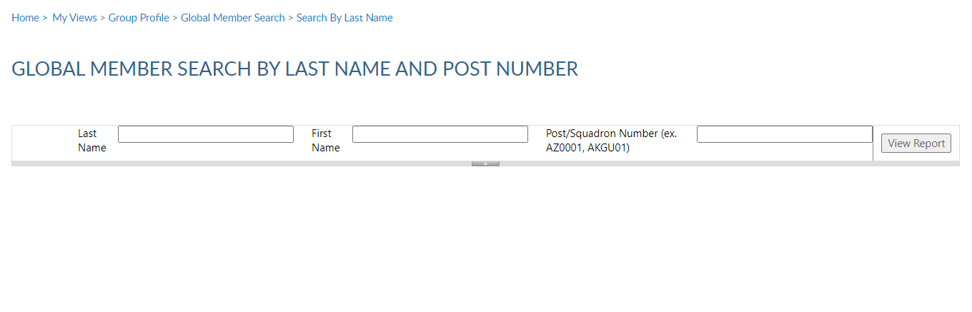
IMPORTANT INFO
Notes:
Search by name and number requires both pieces of information. Click View Report to view. <1>
This information can assist with transferring members and eligibility for The American Legion Auxiliary and Sons of the American Legion.

Slide 34
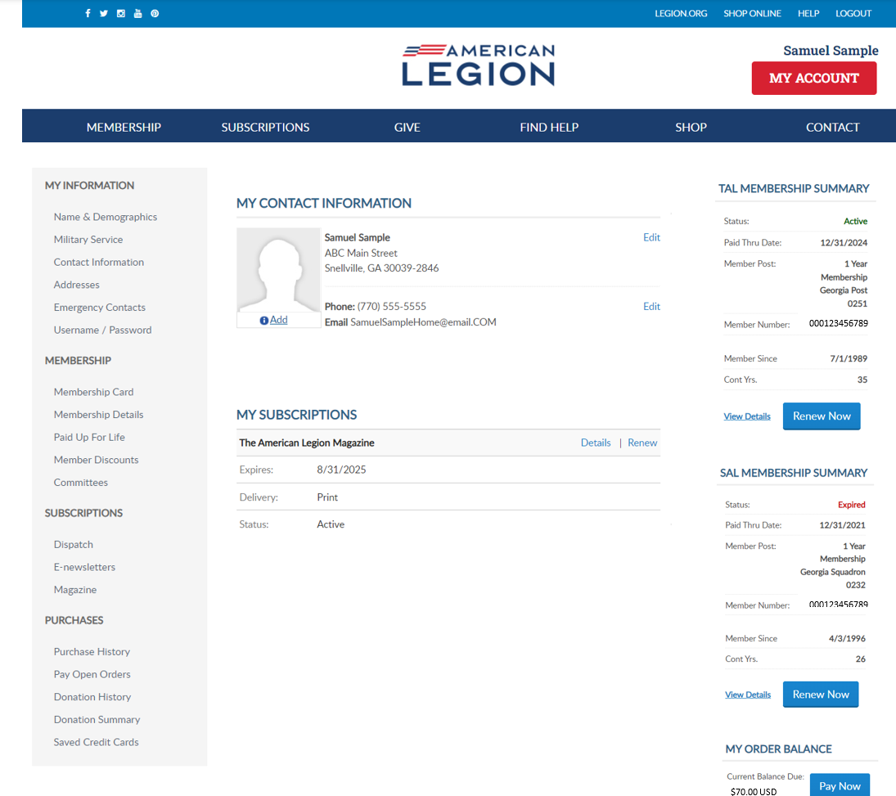
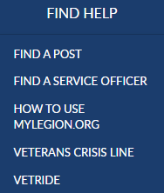
MY ACCOUNT & HELP RESOURCES
Notes:
Learn more about MyLegion using “Find Help” and go to How to use MyLegion.org.

Slide 35
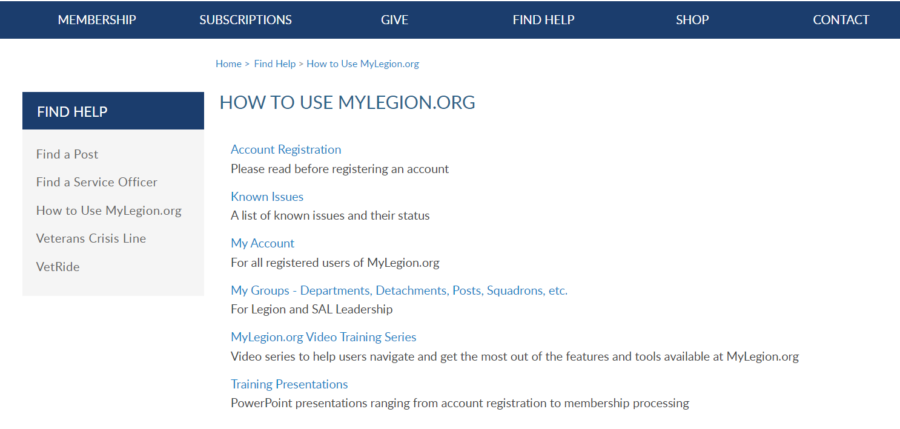
Online Help
Notes:
Step by step instructions, videos and training presentations will assist with how to manage your member account and groups in MyLegion.

Slide 36
Contact your department or national MyLegion support to assist with any questions or help with MyLegion.
MyLegion@legion.org
833.253.9995
Monday – Friday
8:00am – 4:30pm
(Eastern)
Notes:
Contact your department or national MyLegion support to assist with any questions and help with MyLegion.

